Slide 1
Team106online
Sprint 7

Slide 2
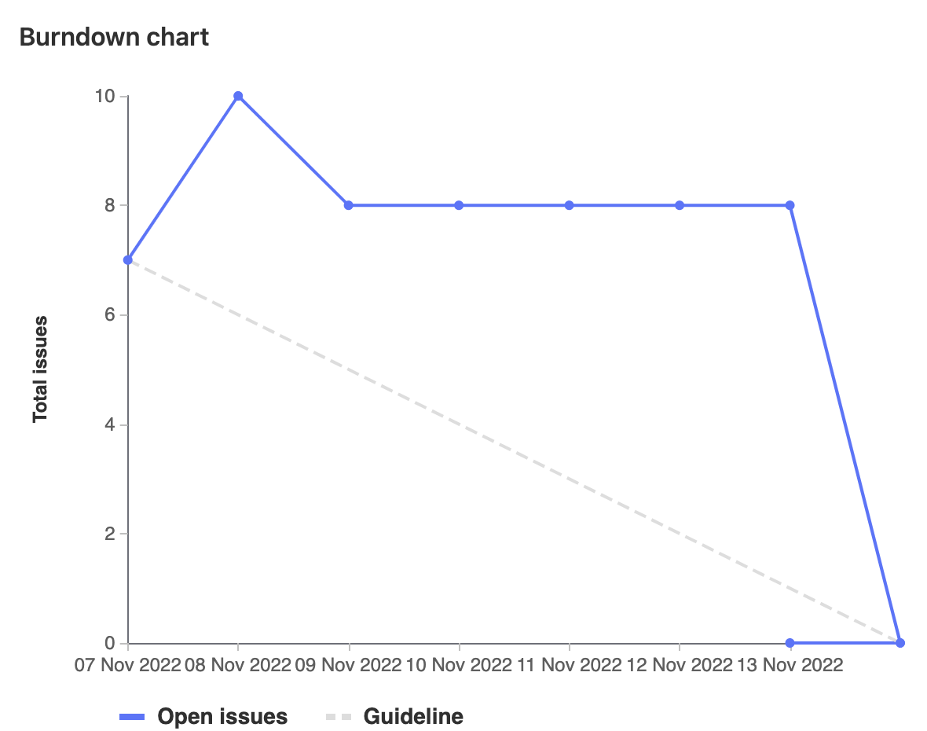
Sprint Progress

Slide 3
What Went Well
What To be Done Differently
Many pair programming sessions
Good communication within team members
Researching and learning about linting and tests
Schedule meetings more often (daily scrum)
Assign tasks sooner

Slide 4
Team Member: Parker Carnegie
Work Highlights:
Total Weights: 10
Sprint planning meetings
Researched linting and best practices
Helped create job dependencies between tests and CI jobs

Slide 5
Team Member: Ivan Odiel Magtangob
Work Highlights:
Total Weights: 12
Researched Python linting with Muhammad
Cookie code review with Alif, Muhammad, Rehan

Slide 6
Team Member: Rehan Nagoor
Work Highlights:
Total Weights: 10
Helped integrating Cookies into the website
Helped Ivan and Salmaan with the linting and auto formatting script for python

Slide 7
Team Member: Hyrum Nantais
Work Highlights:
Total Weights: 14
Created auto-deploy CD job with Sam
Created linting/testing CI jobs with Caleb, Parker, Muhammad

Slide 8
Team Member: Samuel Guilbeault
Work Highlights:
Total Weights: 15
Updated database schema and routes to support different types of search queries
Modified queries to quantify the goodness of search results
Worked on the CD deploy job with Hyrum

Slide 9
Team Member: Muhammad Salmaan
Work Highlights:
Total Weights: 15
Helped with making a linting script using flake8 and formatting using black
Researched Python linting with Ivan
Helped integrating Cookies into the website with Rehan, Alif and Ivan

Slide 10
Team Member: Alif Merchant
Work Highlights:
Total Weights: 13
Created the export functionality for the schedule
Saving cookies to store schedule and query data
Researched linting

Slide 11
Team Member: Caleb Beere
Work Highlights:
Total Weights: 12
Setup a linting standard for out typescript codebase
Created job dependencies between tests and deployments CI jobs
Created lint/test jobs for React

Slide 12

Demo time!

